Slide 1
Amazon Web Services
Notes:
Larry Ellison on Cloud Computing: https://www.youtube.com/watch?v=XZ0jjdp_ZUM

Slide 2
Topics
IT Infrastructure
Cloud Computing
Infrastructure-as-a-Service (IaaS)
Platform-as-a-Service (PaaS)
Software-as-a-Service (SaaS)
Amazon Web Services (AWS)
AWS Global Infrastructure
Popular Services

Slide 3
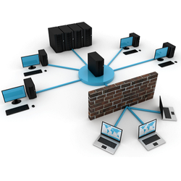
IT Infrastructure
Hardware, software, network resources and services required for the existence, operation and management of an enterprise IT environment
Hardware:
Servers
Computers
Switches, hubs, and routers
Software:
ERP, CRM, Office productivity, etc
Network:
Network enablement
Internet connectivity
Firewall and security

Slide 4
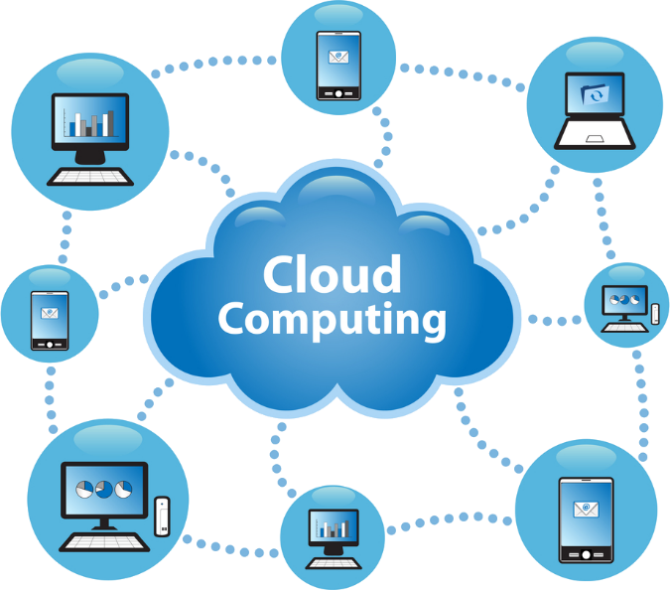
Cloud Computing
Accessing IT infrastructure over the Internet
Infrastructure
Processors
Operating Systems
Hard drives
Platforms
Application servers
Web servers
Databases
Software
CRM, ERP, E-mail, etc.
Nothing stored locally
except an interface to access resources

Slide 5

Infrastructure-as-a-Service (IaaS)
A third-party provider hosts hardware, software, storage and other infrastructure components
IaaS providers handle system maintenance, backup and resiliency planning
Highly scalable resources that can be adjusted on-demand.
Well-suited for temporary, experimental, and spike demands
Automation of administrative tasks
Dynamic scaling
Desktop virtualization
IaaS customers pay on a per-use basis, typically by hour, week, month, or virtual machine space
Pay-as-you-go model eliminates upfront capital expense of building in-house

Slide 6
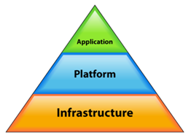
Platform-as-a-Service (PaaS)
Cloud provider delivers hardware and software tools -- usually those needed for application development
Provider hosts the hardware and software on its own infrastructure
Customers can develop or run a new application off-site
Businesses use PaaS for key services
Java development
Application hosting
PaaS includes:
Hardware, operating systems, and middleware (databases, Web servers, etc)
User access or security and application performance monitoring (APM) tools

Slide 7
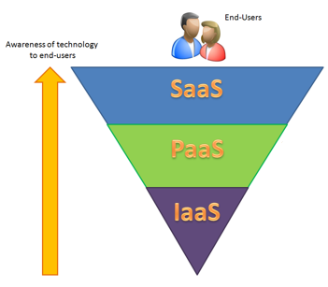
Software-as-a-Service (SaaS)
Software distribution model where applications are hosted by a vendor or service provider and made available to customers over a network, typically the Internet.
Provider hosts commercially available software
Customers access it over the Web
Major SaaS providers include:
SAP
Oracle
Salesforce
Types of software include:
ERP
CRM
SCM

Slide 8
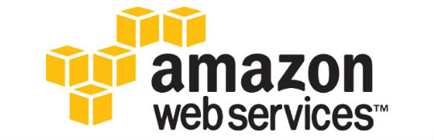
Amazon Web Services (AWS)
Broad set of computing resources hosted by Amazon:
EC2 - Elastic Compute Cloud provides resizable computing capacity in the cloud
EBS - Elastic Block Store provides SSD volumes for use with EC2
Auto-scaling - Scale EC2 capacity up or down automatically
Elastic Load Balancing - Distributes incoming traffic across multiple EC2
RDS - Relational Database Service can set up, operate, and scale a relational database
S3 - Simple Storage Service provides object storage repositories up to 5000+ TB
Route 53 - Route 53 is a cloud Domain Name System (DNS) web service
Many more!

Slide 9

AWS Global Infrastructure
AWS Cloud infrastructure built around Regions and Availability Zones (AZs)
A Region is a physical location with multiple AZs
AZs consist of one or more discrete data centers housed in separate facilities
Redundant power
Networking
Connectivity
AZs offer high availability fault tolerance and scalability
Better than building out a single data center
32 Availability Zones within 12 Regions
Strategically placed to service high Internet-usage areas

Slide 10
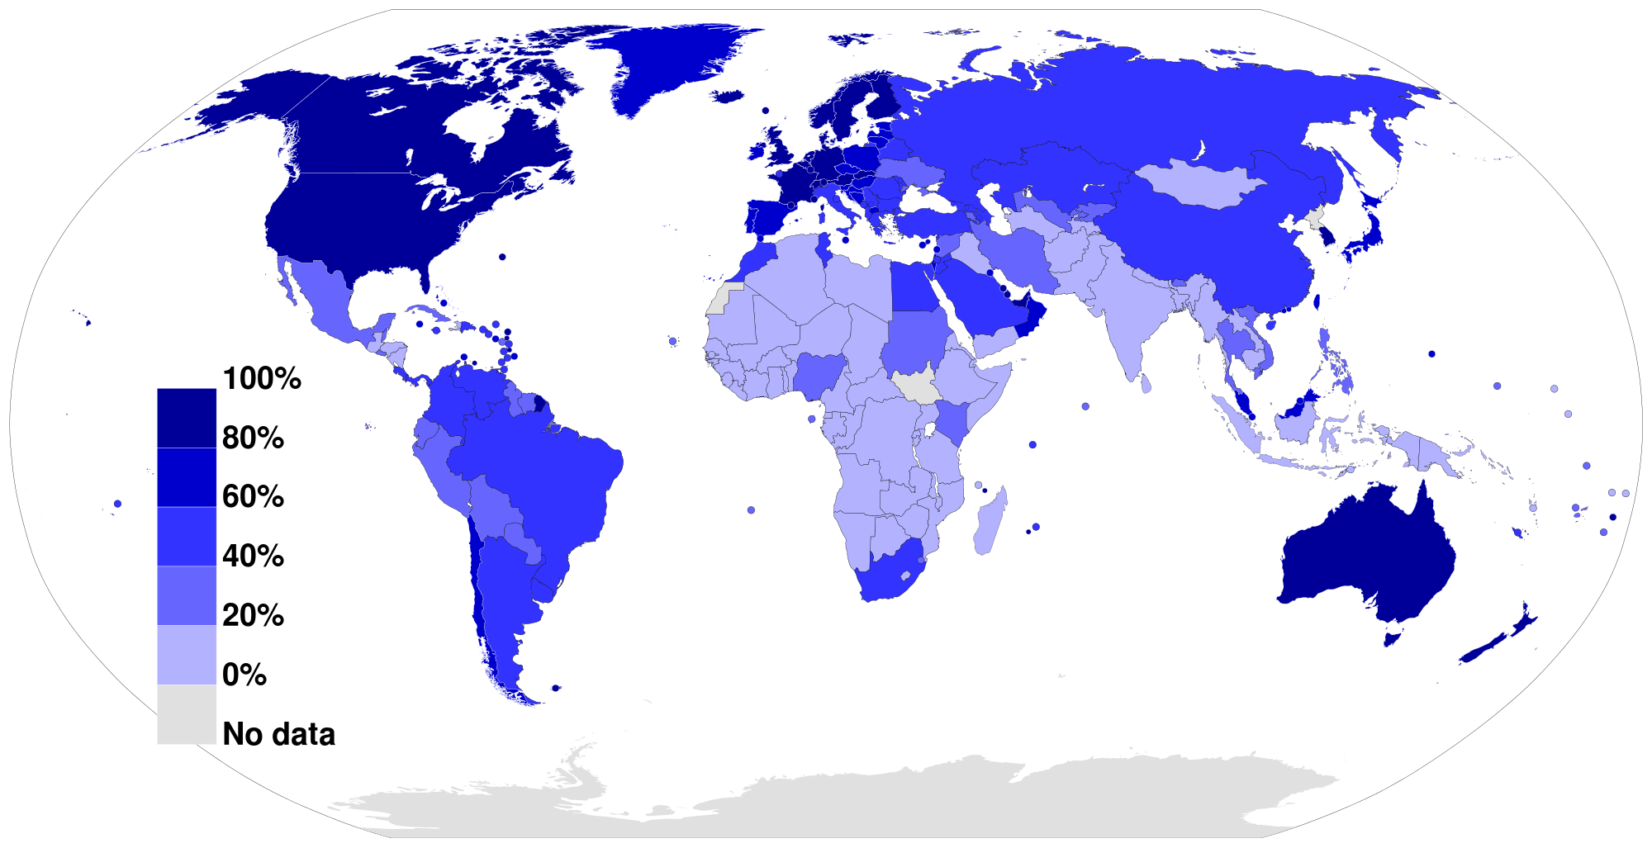
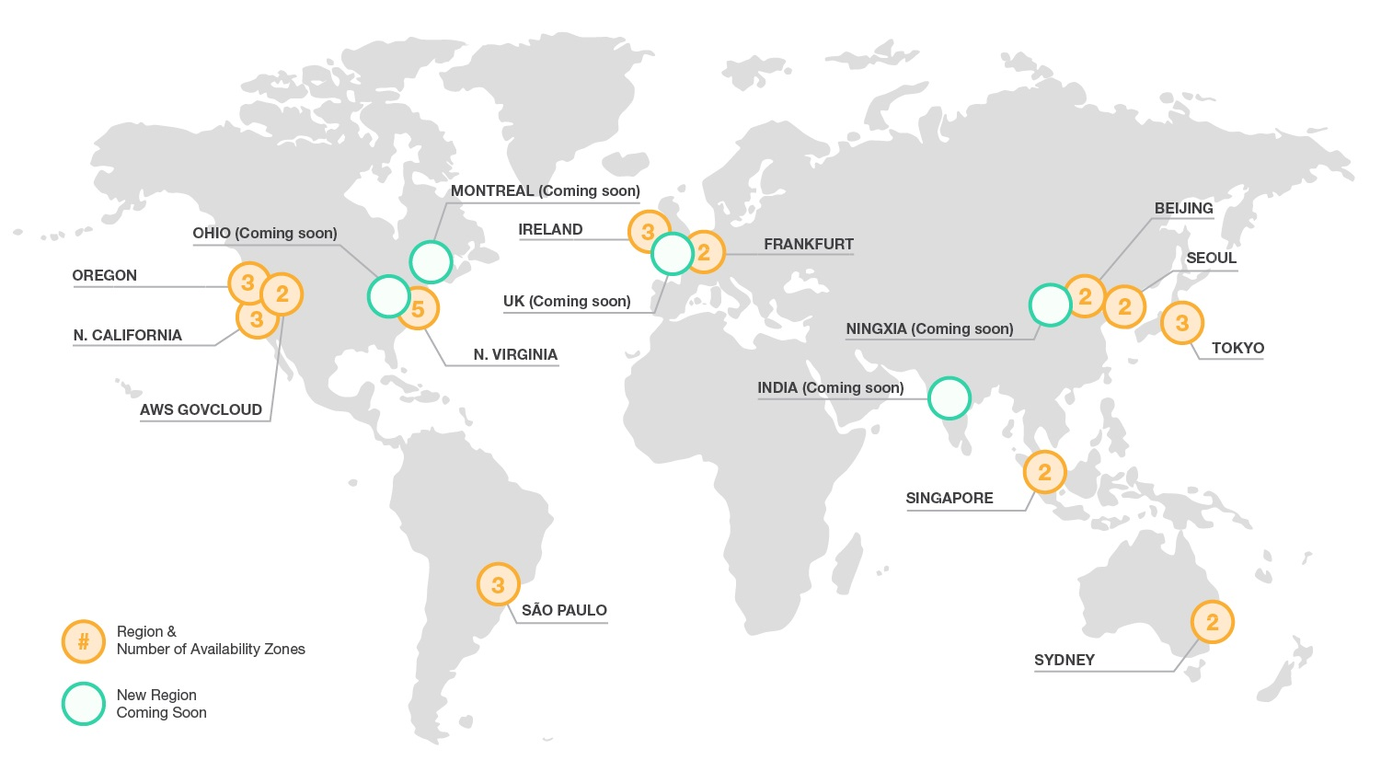
Internet Penetration Map

Slide 11
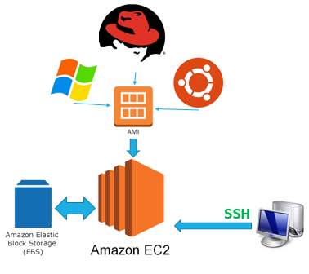
EC2
Elastic Compute Cloud
Create a virtual machine in the cloud
Pay only for what you use
Select AMI (Amazon Machine Image) to load up an OS
Attach EC2 instance to EBS for hard drive space
Connect to Linux using SSH
Connect to Windows using RDP

Slide 12
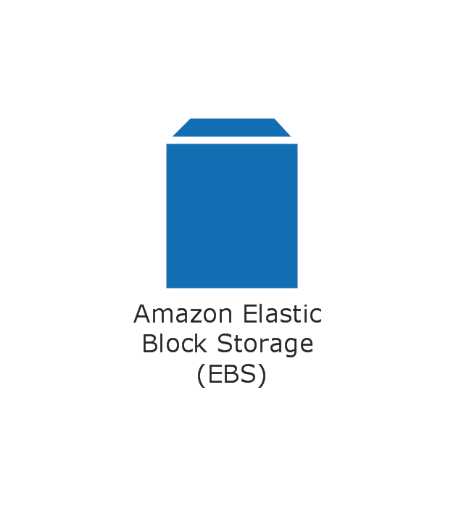
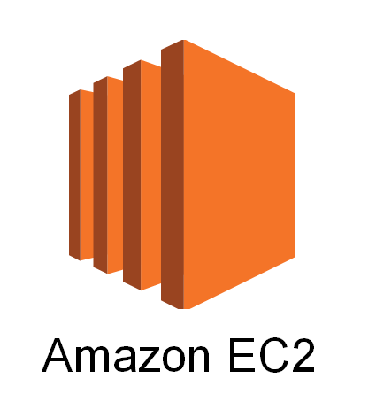
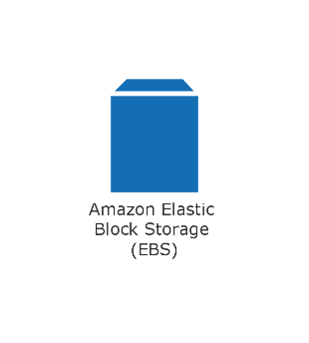
Elastic Block Store
Provides persistent block level storage volumes for EC2
Encryption for secure transfer between EC2 and EBS
Automatically replicated within its AZ
Protection from component failure
High availability and durability
Consistent and low-latency performance
Stripe multiple volumes for higher I/O performance
Backup your data by taking point-in-time snapshots
Copy snapshots across regions enabling:
geographical expansion
data center migration
disaster recovery
Vertically scale your usage up or down within minutes

Slide 13
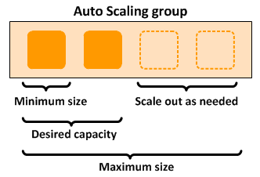
Auto-Scaling
Ensure you have enough EC2 instances to handle application load
You create collections of EC2 instances, called Auto Scaling groups.
Specify scaling policies and Auto Scaling can launch or terminate instances as demand on your application increases or decreases.
Specify the minimum number of instances
Specify the maximum number of instances
Specify the desired capacity in each Auto Scaling group

Slide 14
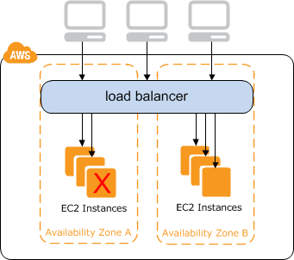
Elastic Load Balancing
Distribute incoming application traffic
Maintain healthy EC2 instances with ELB group
Fault tolerance (instances in a single or multiple AZs)
Amazon Route 53 health checking and DNS failover features
Fail away from a load balancer if there are no healthy EC2’s
Auto Scaling with Elastic Load Balancing
Load balancer with Virtual Private Cloud (VPC)
Specify whether load balancer is Internet-facing or internal

Slide 15



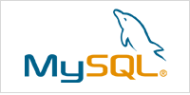


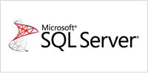
RDS
Relational Database Service
Set up, operate, and scale a relational database in the cloud
Cost-efficient and resizable capacity
Manages time-consuming database administration tasks
Backup and restore with point-in-time recovery
Database performance monitoring tools
Amazon RDS provides six familiar database engines

Slide 16

S3
Amazon Simple Storage Service
Secure, durable, highly-scalable object storage
SLA guarantees 99.99% availability
Easy to use with a simple web service interface to store and retrieve data
Pay only for the storage you actually use
Variety of use cases including
Cloud applications
Content distribution
Backup and archiving
Disaster recovery
Big data analytics

Slide 17

Route 53
Domain Name System (DNS) web service.
Route end users to Internet applications using DNS
i.e. Translate google.com to 74.125.226.6
Configure DNS health checks
Route traffic to healthy endpoints
Monitor application and endpoint health
Route 53 offers Domain Name Registration
Route users to EC2 instances, load balancers, S3 buckets, or infrastructure outside of AWS
Route 53 Traffic Flow can manage traffic globally through a variety of routing types

Slide 18
Review
IT Infrastructure
Cloud Computing
Infrastructure-as-a-Service (IaaS)
Platform-as-a-Service (PaaS)
Software-as-a-Service (SaaS)
Amazon Web Services (AWS)
AWS Global Infrastructure
Popular Services

